Slide 1
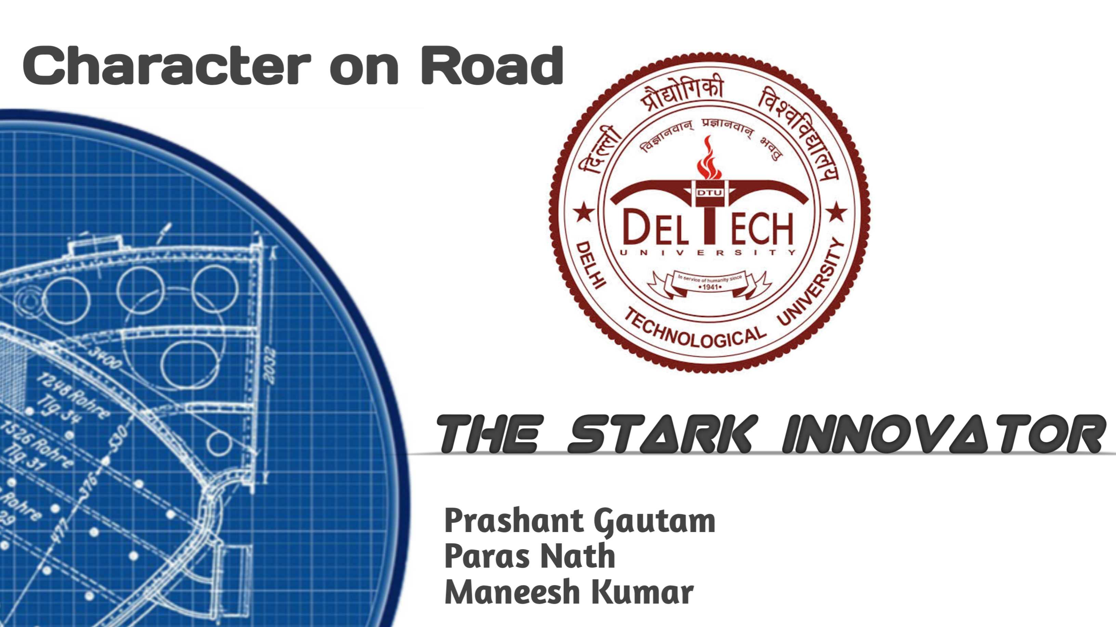

Slide 2

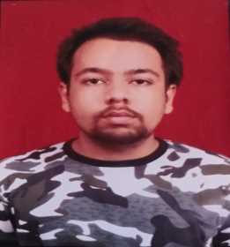

Team details
TEAM NAME: THE STARK INNOVATOR
PARAS NATH
PRASHANT GAUTAM
College : Delhi Technological University (DTU), New Delhi
Stream: CIVIL ENGINEERING
B.TECH 4th YEAR
College : Delhi Technological University (DTU), New Delhi
Stream: CIVIL ENGINEERING
B.TECH 4th YEAR
ABOUT US
● 3rd Rank on National Level in NSG (National Security Guard) Hackathon. Made Virtual Combat Simulator machine for NSG Black commandos to trained army.
● Second Position on Zonal Level science competition . Made a Laser Alarm System for Banks and office.
● Made a Talking non Motile Robot
● Made Bump Integrator &Made a Smart Cloth Band IoT watch
MANEESH KUMAR
Photo
College : Delhi Technological University (DTU), New Delhi
Stream: COMPUTER ENGINEERING
B.TECH 3rd YEAR
All fields are mandatory

Slide 3
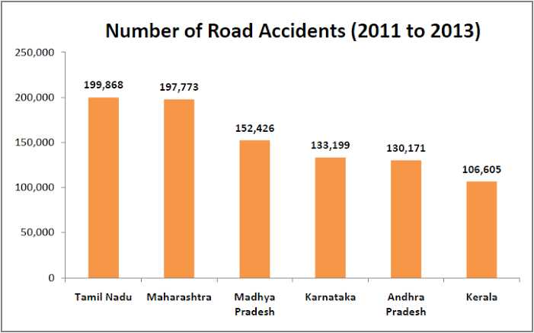
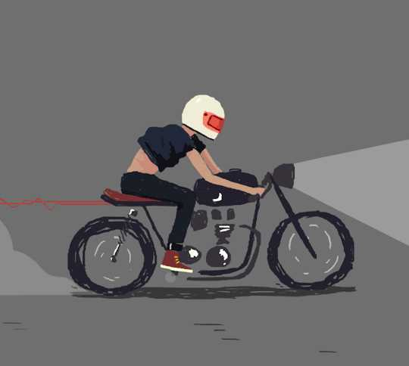

ROAD Accident in INDIA

Slide 4

S.A.S and Compact Bump Integrator

Slide 5
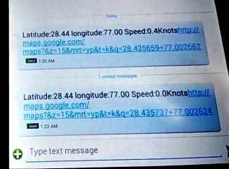
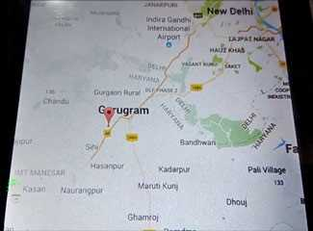
VEHICLES WITH ACCIDENT ALERT SYSTEM :
Google Pixel’s Car Crash Detection Feature:
Available in Google Pixel Phone starting from Pixel 4A.
Price to this phone is Rs. 99,900
On-Board Units in Vehicles:
The price of an on-board unit (OBU) that can detect accidents can vary depending on the manufacturer, the features of the OBU, and the quantity purchased. However, they typically range in price from 10k to 40k per unit.

Slide 6
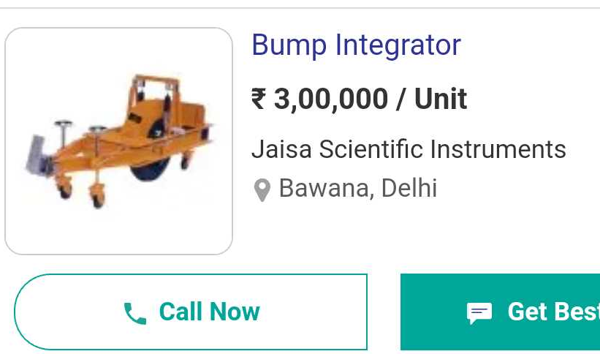
Problem Statement
The challenge involves strengthening of Security Alert System (SAS) and creating a cost-effective, compact version of the bump integrator, a road quality assessment machine. The IOT-based prototype will send real-time WhatsApp alerts to enhance passenger safety by notifying family members and hospitals in case of accidents or road hazards.
Our Device is in under 800₹

Slide 7

Unique Idea 💡
This solution innovatively differentiates itself from traditional road quality checking machines, which rely on expensive mechanical systems, by adopting a cost-effective electronic and sensor-based IOT approach. Moreover, it stands out by introducing an accident alert system not commonly found in regular vehicles, effectively transforming any vehicle into a smart one. The system's ability to detect accidents through sudden jerk or acceleration changes on the x-axis is another unique feature.

Slide 8






Effects of Uneveness
Pain
Fatigue
Vehicle Damage
Mental stress
Fuel consumption
Exceed Time
Physical Impact on Body
Mentally Impact
Effects on Vehicle

Slide 9
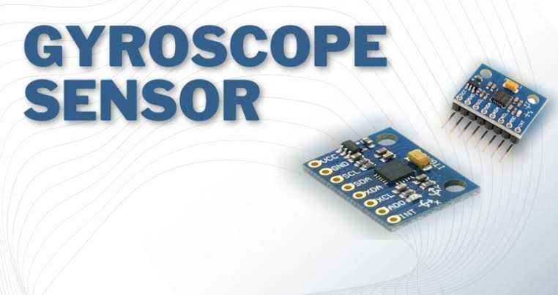
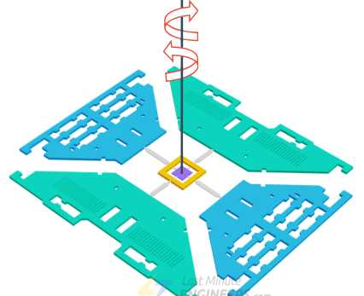
Accelerometer sensor to determine the Roughness of road
Methods and Technology
We can find the comfortability index by measuring the jerk during the ride .
This sensor can be further integrated to measure the vertical jerks to check quality of roads and horizontal jerks in case road accidents.

Slide 10





DEMO

Slide 11
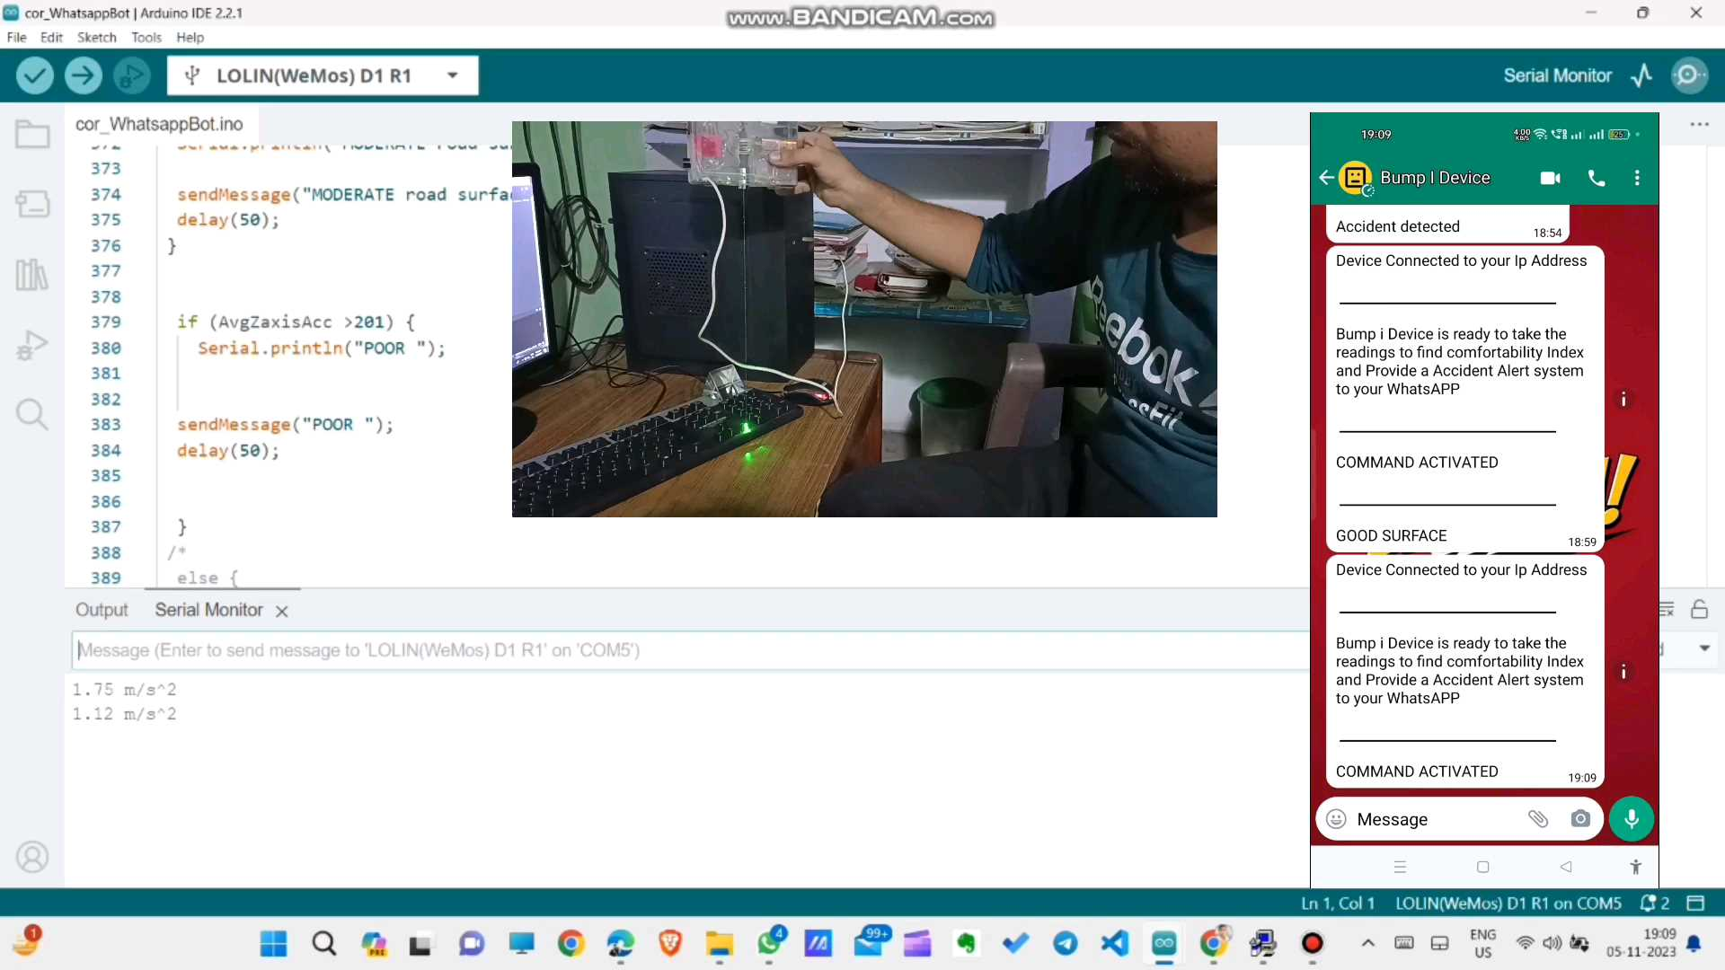

Slide 12


Solution
The solution offers a triple benefit:
It stimulates economic growth by reducing accident-related costs, strengthens national development through enhanced road infrastructure.
lowers accident death rates, resulting in a healthier and more productive workforce.
This multifaceted approach can lead to a more prosperous and thriving country.

Slide 13
Thank you

